Slide 1
PGM 2002/03 Tirgul 2-3
The Bayesian Network Representation

Slide 2
Introduction
In class we saw the Markov Random Field (Markov Networks) representation using an undirected graph. Many distributions are more naturally captured using a directed mode. Bayesian networks (BNs) are the directed cousin of MRFs and compactly represent a distribution using local independence properties. In this tirgul we will review these local properties for directed models, factorization for BNs, d-sepraration reasoning patterns, I-maps and P-maps.

Slide 3
Example: Family trees
Noisy stochastic process:
Example: Pedigree
A node represents
an individual’s
genotype
Homer
Marge
Bart
Lisa
Maggie
Modeling assumptions:
  Ancestors can effect descendants' genotype only by passing genetic materials through intermediate generations

Slide 4
Markov Assumption
Ancestor
We now make this independence assumption more precise for directed acyclic graphs (DAGs)
Each random variable X, is independent of its non-descendents, given its parents Pa(X)
Formally,
Ind(X; NonDesc(X) | Pa(X))
Parent
Y₁
Y₂
X
Non-descendent
Non-descendent
Descendent

Slide 5
Markov Assumption Example
Earthquake
Burglary
Radio
Alarm
In this example:
  Ind( E; B )
  Ind( B; E, R )
  Ind( R; A, B, C | E )
  Ind( A; R | B,E )
  Ind( C; B, E, R | A)
Call

Slide 6
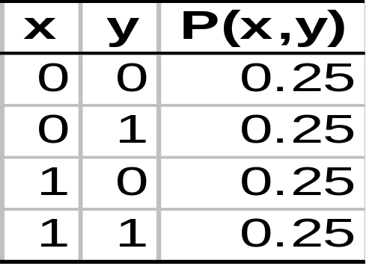
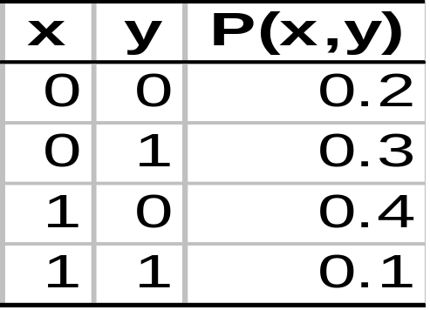
I-Maps
A DAG G is an I-Map of a distribution P if the all Markov assumptions implied by G are satisfied by P
  (Assuming G and P both use the same set of random variables)
Examples:
X
Y
X
Y

Slide 7
Factorization
Given that G is an I-Map of P, can we simplify the representation of P?
Example:
Since Ind(X;Y), we have that P(X|Y) = P(X)
Applying the chain rule
P(X,Y) = P(X|Y) P(Y) = P(X) P(Y)
Thus, we have a simpler representation of P(X,Y)
X
Y

Slide 8
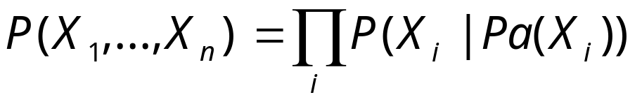
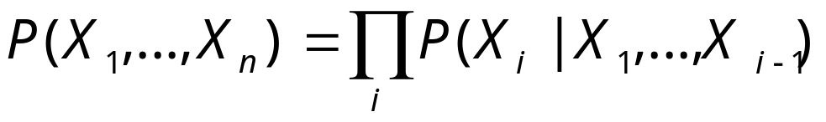
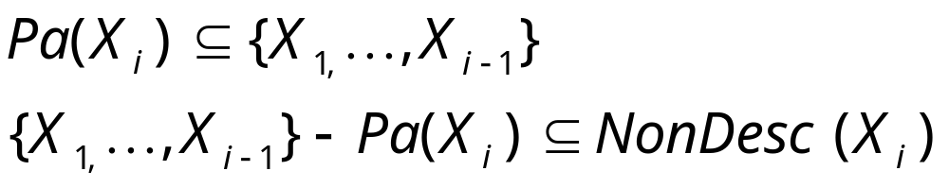
Factorization Theorem
Thm: if G is an I-Map of P, then
Proof:
By chain rule:
wlog. X₁,…,X_{n} is an ordering consistent with G
From assumption:
Since G is an I-Map, Ind(X_{i}; NonDesc(X_{i})| Pa(X_{i}))
Hence,
We conclude, P(X_{i} | X₁,…,X_{i-1}) = P(X_{i} | Pa(X_{i}) )

Slide 9
Factorization Example
Earthquake
Burglary
Radio
Alarm
Call
P(C,A,R,E,B) = P(B)P(E|B)P(R|E,B)P(A|R,B,E)P(C|A,R,B,E)
versus
P(C,A,R,E,B) = P(B) P(E) P(R|E) P(A|B,E) P(C|A)

Slide 10
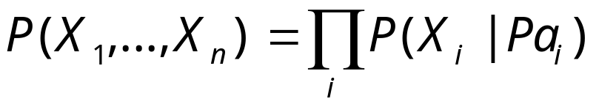
Bayesian Networks
A Bayesian network specifies a probability distribution via two components:
  A DAG G
  A collection of conditional probability distributions P(X_{i}|Pa_{i})
The joint distribution P is defined by the factorization
Additional requirement: G is a (minimal) I-Map of P

Slide 11
Consequences
We can write P in terms of “local” conditional probabilities
If G is sparse,
  that is, |Pa(X_{i})| < k ,
⇒ each conditional probability can be specified compactly
  e.g. for binary variables, these require O(2^{k}) params.
⇒ representation of P is compact
  linear in number of variables

Slide 12
Conditional Independencies
Let Markov(G) be the set of Markov Independencies implied by G
The decomposition theorem shows
  G is an I-Map of P ⇒
We can also show the opposite:
Thm:
⇒ G is an I-Map of P

Slide 13
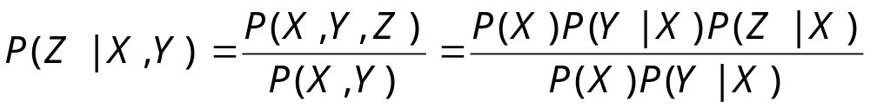
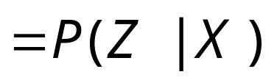
Proof (Outline)
X
Z
Example:
Y

Slide 14
Markov Blanket
We’ve seen that Pa_{i} separate X_{i} from its non-descendents
What separates X_{i} from the rest of the nodes?
Markov Blanket:
Minimal set Mb_{i} such that
Ind(X_{i} ; {X₁,…,X_{n}} - Mb_{i} - {X_{i} } | Mb_{i} )
To construct that Markov blanket we need to consider all paths from X_{i} to other nodes

Slide 15
Markov Blanket (cont)
Three types of Paths:
“Upward” paths
  Blocked by parents
X

Slide 16
Markov Blanket (cont)
Three types of Paths:
“Upward” paths
  Blocked by parents
“Downward” paths
  Blocked by children
X

Slide 17
Markov Blanket (cont)
Three types of Paths:
“Upward” paths
  Blocked by parents
“Downward” paths
  Blocked by children
“Sideway” paths
  Blocked by “spouses”
X

Slide 18
Markov Blanket (cont)
We define the Markov Blanket for a DAG G
Mb_{i} consist of
  Pa_{i}
  X_{i}’s children
  Parents of X_{i}’s children (excluding X_{i})
Easy to see: If X_{j} in Mb_{i} then X_{i} in Mb_{j}

Slide 19
Implied (Global) Independencies
Does a graph G imply additional independencies as a consequence of Markov(G)
We can define a logic of independence statements
We already seen some axioms:
  Ind( X ; Y | Z ) ⇒ Ind( Y; X | Z )
  Ind( X ; Y₁, Y₂ | Z ) ⇒ Ind( X; Y₁ | Z )
We can continue this list..

Slide 20
d-separation
A procedure d-sep(X; Y | Z, G) that given a DAG G, and sets X, Y, and Z returns either yes or no
Goal:
  d-sep(X; Y | Z, G) = yes iff Ind(X;Y|Z) follows from Markov(G)

Slide 21
Paths
Intuition: dependency must “flow” along paths in the graph
A path is a sequence of neighboring variables
Examples:
R ← E → A ← B
C ← A ← E → R
Earthquake
Burglary
Radio
Alarm
Call

Slide 22
Paths blockage
We want to know when a path is
  active -- creates dependency between end nodes
  blocked -- cannot create dependency end nodes
We want to classify situations in which paths are active given the evidence.

Slide 23
Path Blockage
Three cases:
  Common cause
Blocked
Blocked
Unblocked
Active
E
E
R
A
R
A

Slide 24
Path Blockage
Three cases:
  Common cause
  Intermediate cause
Blocked
Blocked
Unblocked
Active
E
E
A
A
C
C

Slide 25
Path Blockage
Three cases:
  Common cause
  Intermediate cause
  Common Effect
Blocked
Blocked
Unblocked
Active
E
B
E
B
A
A
C
E
B
C
A
C

Slide 26
Path Blockage -- General Case
A path is active, given evidence Z, if
Whenever we have the configuration
B or one of its descendents are in Z
No other nodes in the path are in Z
A path is blocked, given evidence Z, if it is not active.
A
C
B

Slide 27
Example
  d-sep(R,B) = yes
E
B
R
A
C

Slide 28
Example
  d-sep(R,B) = yes
  d-sep(R,B|A) = no
E
B
R
A
C

Slide 29
Example
  d-sep(R,B) = yes
  d-sep(R,B|A) = no
  d-sep(R,B|E,A) = yes
E
B
R
A
C

Slide 30
d-Separation
X is d-separated from Y, given Z, if all paths from a node in X to a node in Y are blocked, given Z.
Checking d-separation can be done efficiently
(linear time in number of edges)
  Bottom-up phase:
  Mark all nodes whose descendents are in Z
  X to Y phase:
  Traverse (BFS) all edges on paths from X to Y and check if they are blocked

Slide 31
Soundness
Thm:
If
  G is an I-Map of P
  d-sep( X; Y | Z, G ) = yes
then
  P satisfies Ind( X; Y | Z )
Informally,
Any independence reported by d-separation is satisfied by underlying distribution

Slide 32
Completeness
Thm:
If d-sep( X; Y | Z, G ) = no
then there is a distribution P such that
  G is an I-Map of P
  P does not satisfy Ind( X; Y | Z )
Informally,
Any independence not reported by d-separation might be violated by the underlying distribution
We cannot determine this by examining the graph structure alone

Slide 33
Reasoning Patterns
Causal reasoning / prediction
P(A|E,B),P(R|E)?
Evidential reasoning / explanation
P(E|C),P(B|A)?
Inter-causal reasoning
P(B|A) >?< P(B|A,E)?
Earthquake
Burglary
Radio
Alarm
Call

Slide 34
I-Maps revisited
The fact that G is I-Map of P might not be that useful
For example, complete DAGs
  A DAG G is complete if we cannot add an arc without creating a cycle
These DAGs do not imply any independencies
Thus, they are I-Maps of any distribution
X₁
X₂
X₁
X₂
X₃
X₄
X₃
X₄

Slide 35
Minimal I-Maps
A DAG G is a minimal I-Map of P if
G is an I-Map of P
If G’ ⊂ G, then G’ is not an I-Map of P
That is, removing any arc from G introduces (conditional) independencies that do not hold in P

Slide 36
Minimal I-Map Example
If is a minimal I-Map
Then, these are not I-Maps:
X₁
X₂
X₃
X₄
X₁
X₂
X₁
X₂
X₃
X₄
X₃
X₄
X₁
X₂
X₁
X₂
X₃
X₄
X₃
X₄

Slide 37
Constructing minimal I-Maps
The factorization theorem suggests an algorithm
Fix an ordering X₁,…,X_{n}
For each i,
  select Pa_{i} to be a minimal subset of {X₁,…,X_{i-1} },
  such that Ind(X_{i} ; {X₁,…,X_{i-1} } - Pa_{i} | Pa_{i} )
Clearly, the resulting graph is a minimal I-Map.

Slide 38
Non-uniqueness of minimal I-Map
Unfortunately, there may be several minimal I-Maps for the same distribution
  Applying I-Map construction procedure with different orders can lead to different structures
Order: C, R, A, E, B
Original I-Map
E
B
E
B
R
A
R
A
C
C

Slide 39
Choosing Ordering & Causality
The choice of order can have drastic impact on the complexity of minimal I-Map
Heuristic argument:
construct I-Map using causal ordering among variables
Justification?
  It is often reasonable to assume that graphs of causal influence should satisfy the Markov properties.
  We will revisit this issue in future classes

Slide 40
P-Maps
A DAG G is P-Map (perfect map) of a distribution P if
  Ind(X; Y | Z) if and only if
  d-sep(X; Y |Z, G) = yes
Notes:
A P-Map captures all the independencies in the distribution
P-Maps are unique, up to DAG equivalence

Slide 41
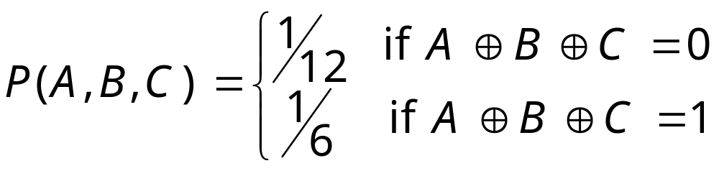
P-Maps
Unfortunately, some distributions do not have a P-Map
Example:
A minimal I-Map:
This is not a P-Map since Ind(A;C) but d-sep(A;C) = no
A
B
C

